Slide 1

Introduction
Insertion
Deletion

Slide 2
Balance Binary Search Tree
Worst case height of binary search tree: N
  Insertion, deletion can be O(N) in the worst case
We want a tree with small height
Height of a binary tree with N node is at least Θ(log N)
Goal: keep the height of a binary search tree O(log N)
Balanced binary search trees
  Examples: AVL tree, red-black tree

Slide 3
Balanced Tree?
Suggestion 1: the left and right subtrees of root have the same height
Suggestion 2: every node must have left and right subtrees of the same height
Our choice: for each node, the height of the left and right subtrees can differ at most 1,-1,0.

Slide 4
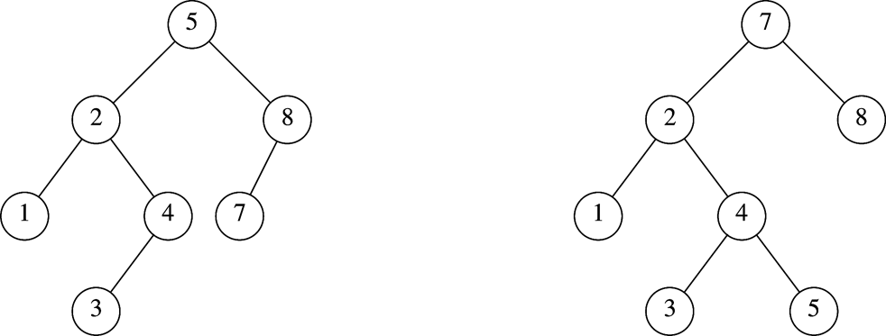
AVL Tree
An AVL (Adelson-Velskii and Landis 1962) tree is a binary search tree in which
  for every node in the tree, the height of the left and right subtrees differ by at most 1.
AVL tree
AVL property violated here

Slide 5

N₁ = 1
N₂ = 2
N₃ =4
N₄ = N₂+N₃+1=7

Slide 6
Height of AVL Tree
Denote N_{h} the minimum number of nodes in an AVL tree of height h
N₁=1, N₂ =2 (base)
N_{h}= N_{h-1} + N_{h-2} +1 (recursive relation)
many operations (i.e. searching) on an AVL tree will take O(log N) time

Slide 7
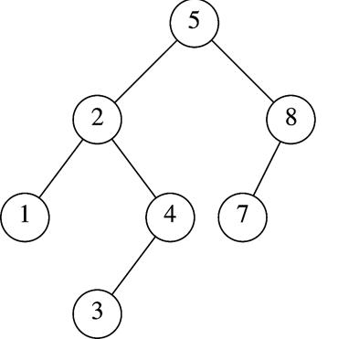
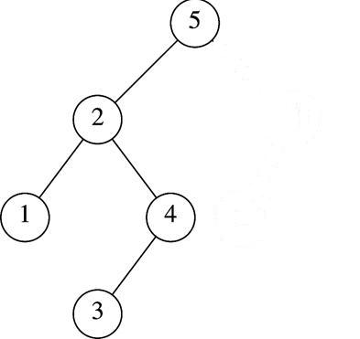
Insertion in AVL Tree
Basically follows insertion strategy of binary search tree
  But may cause violation of AVL tree property
Restore the destroyed balance condition if needed
7
6
8
6
Insert 6
Property violated
Original AVL tree
Restore AVL property

Slide 8
Some Observations
After an insertion, only nodes that are on the path from the insertion point to the root might have their balance altered
  Because only those nodes have their subtrees altered
Rebalance the tree at the deepest such node guarantees that the entire tree satisfies the AVL property
7
6
8
6
Node 5,8,7 might
have balance altered
Rebalance node 7
guarantees the whole tree be AVL

Slide 9
Different Rebalancing Rotations
The rebalancing rotations are classified as LL, LR, RR and RL as illustrated below, based on the position of the inserted node with reference to α.
  LL rotation: Inserted node is in the left subtree of the left subtree of node α
  RR rotation: Inserted node is in the right subtree of the right subtree of node α
  LR rotation: Inserted node is in the right subtree of the left subtree of node α
  RL rotation: Inserted node is in the left subtree of the right subtree of node α

Slide 10

Insertion Analysis
Insert the new key as a new leaf just as in ordinary binary search tree: O(logN)
Then trace the path from the new leaf towards the root, for each node x encountered: O(logN)
  Check height difference: O(1)
  If satisfies AVL property, proceed to next node: O(1)
  If not, perform a rotation: O(1)
The insertion stops when
  A single rotation is performed
  Or, we’ve checked all nodes in the path
Time complexity for insertion O(logN)
logN

Slide 11

Basically follows deletion strategy of binary search tree
  But may cause violation of AVL tree property
Restore the destroyed balance condition if needed
20
20
10
35
15
35
5
15
25
40
10
18
25
40
18
30
38
45
30
38
45
50
50
Delete 5, Node 10 is unbalanced
Single Rotation

Slide 12

20
35
15
35
20
40
10
18
25
40
15
25
38
45
30
38
45
10
18
30
50
Continue to check parents
Oops!! Node 20 is unbalanced!!
50
Single Rotation
For deletion, after rotation, we need to continue tracing upward to see if AVL-tree property is violated at other node.
Different rotations are classified in R0, R1, R-1, L0, L1 And L-1

Slide 13

Different rotations
An element can be deleted from AVL tree which may change the BF of a node such that it results in unbalanced tree.
Some rotations will be applied on AVL tree to balance it.
R rotation is applied if the deleted node is in the right subtree of node A (A is the node with balance factor other than 0, 1 and -1).
L rotation is applied if the deleted node is in the left subtree of node A.
Notes:
목차
자바의 생성배경
자바를 사용하는 이유
과거, 현재, 미래의 자바
자바의 발전과정
버전별 JDK에 대한 설명
자바와 C++의 차이점
자바의 성능
자바 관련 산업(?)의 경향

Slide 14
Different rotations cont…
Suppose we have deleted node X from the tree.
A is the closest ancestor node on the path from X to the root node, with a balance factor -2 or +2.
B is the desendent of node A on the opposite subtree of deleted node i.e. if the deleted node is on left side the B is the desendent on the right subtree of A or the root of right subtree of A.
Notes:
목차
자바의 생성배경
자바를 사용하는 이유
과거, 현재, 미래의 자바
자바의 발전과정
버전별 JDK에 대한 설명
자바와 C++의 차이점
자바의 성능
자바 관련 산업(?)의 경향

Slide 15
R Rotation
R Rotation is applied when the deleted node is in the right subtree of node A.
There are three different types of rotations based on the balanced factor of node B.
R0 Rotation: When the balance Factor of node B is 0.
  Apply LL Rotation on node A.
R1 Rotation: When the balance Factor of node B is +1.
  Apply LL Rotation on node A.
R-1 Rotation: When the balance Factor of node B is -1.
  Apply LR Rotation(RR rotation on B and LL rotation on node A).
Notes:
목차
자바의 생성배경
자바를 사용하는 이유
과거, 현재, 미래의 자바
자바의 발전과정
버전별 JDK에 대한 설명
자바와 C++의 차이점
자바의 성능
자바 관련 산업(?)의 경향

Slide 16
L Rotation
L Rotation is applied when the deleted node is in the left subtree of node A.
There are three different types of rotations based on the balanced factor of node B.
L0 Rotation: When the balance Factor of node B is 0.
  Apply RR Rotation on node A.
L-1 Rotation: When the balance Factor of node B is -1.
  Apply RR Rotation on node A.
L1 Rotation: When the balance Factor of node B is +1.
  Apply RL Rotation(LL rotation on B and RR rotation on node A).
Notes:
목차
자바의 생성배경
자바를 사용하는 이유
과거, 현재, 미래의 자바
자바의 발전과정
버전별 JDK에 대한 설명
자바와 C++의 차이점
자바의 성능
자바 관련 산업(?)의 경향

Slide 17



